Slide 1
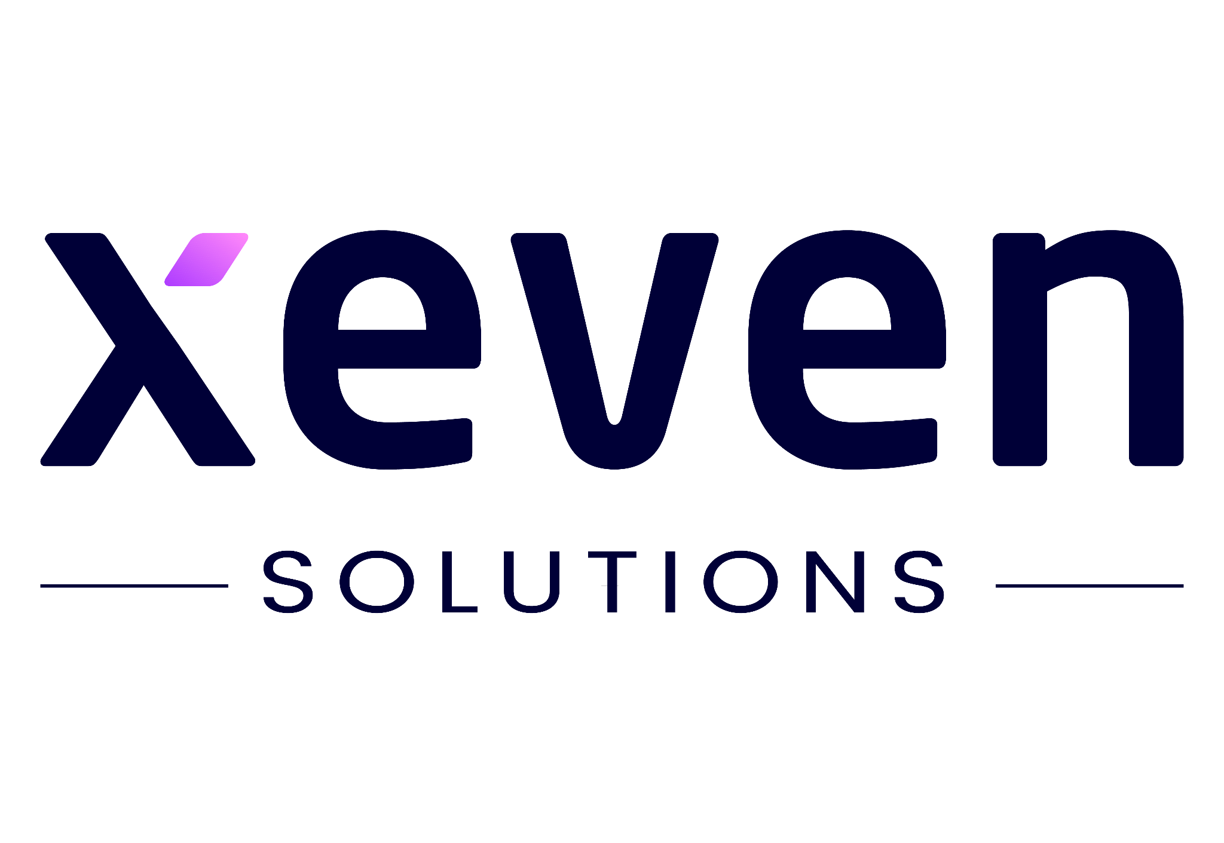

Lecture 02
Irfan Malik
Dr. Sheraz Naseer

Slide 2
Agenda
Machine Learning
Types of Machine Learning
Deep Learning
Generative AI

Slide 3
Previous lecture:
Lecture 01 - Road Map of AI
Click Here

Slide 4
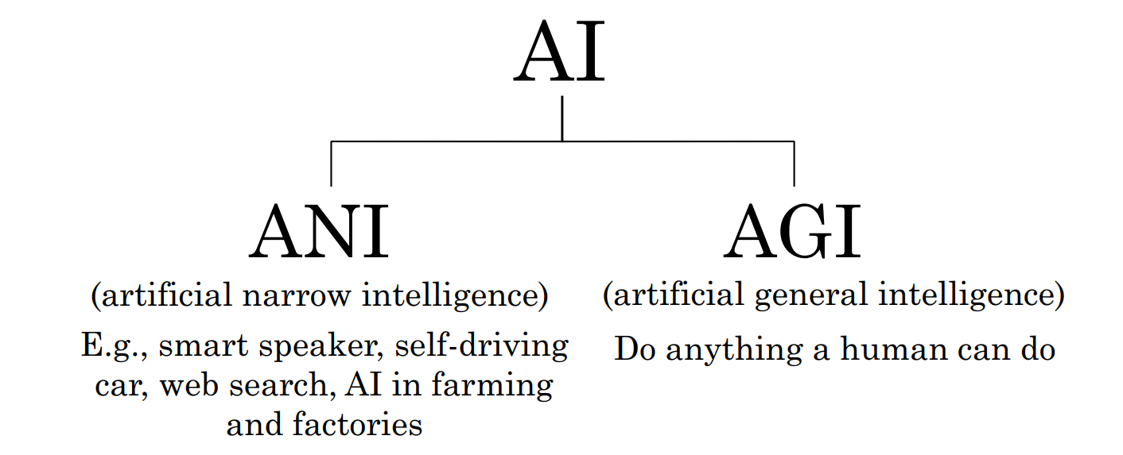
Demystifying AI
Source: Deeplearning.ai

Slide 5
Relationship in AI, ML and DL
Machine Learning:
SVM, Tree Algorithms, Nearest neighbors, bagging, boosting, Deep Learning
Artificial Intelligence:
Search Algorithms, Rule Based Systems, Statistical Inference, Machine Learning
Deep Learning:
FCNs, CNNs, RNNs, Transformers, Autoencoders, GANs

Slide 6
ANI (Artificial Narrow Intelligence)
ANI refers to AI systems that are designed and trained for specific tasks or domains. These systems excel at performing a single task or a narrow range of tasks, but they lack the ability to generalize their knowledge to other domains.
Examples:
ANI include virtual assistants like Siri or Alexa, recommendation systems, and image recognition algorithms.

Slide 7
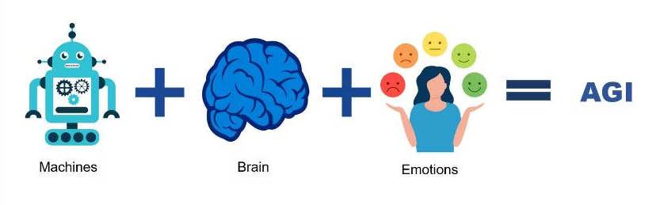
AGI (Artificial General Intelligence):
AGI, on the other hand, refers to AI systems that possess the ability to understand, learn, and apply knowledge across a wide range of tasks and domains, similar to human intelligence.

Slide 8
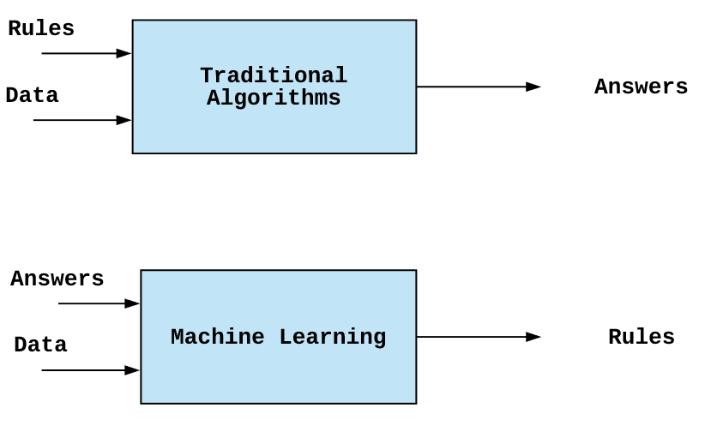
Difference in ML and Classical AI

Slide 9
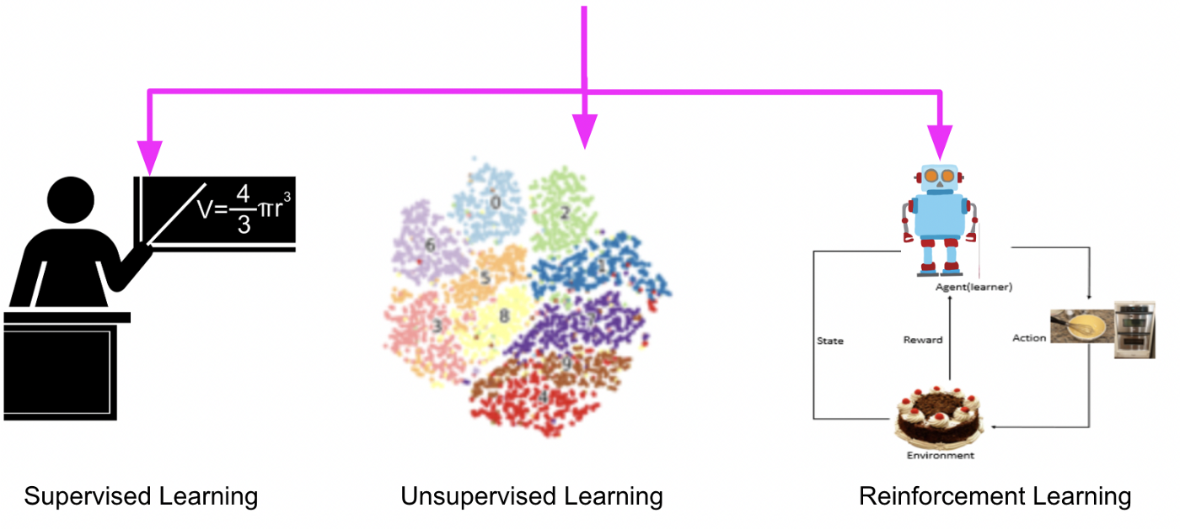
Types of Machine Learning
Supervised Learning (learning with labeled data)
Unsupervised Learning (discover patterns in unlabeled data)
Reinforcement learning (learn to act based on feedback/rewards)

Slide 10
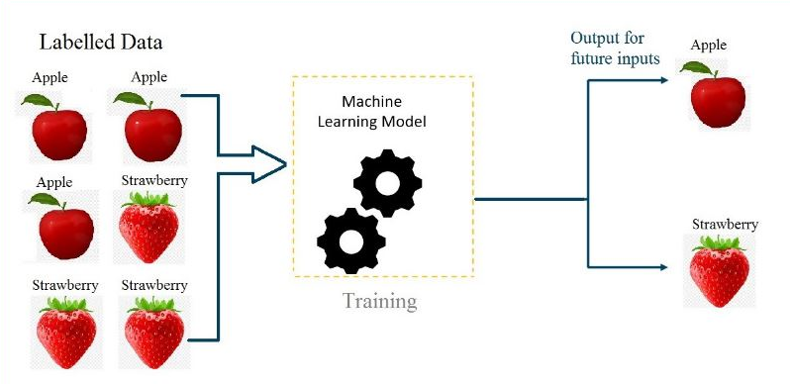
Supervised learning:
Supervised learning is a category of machine learning that uses labeled datasets to train algorithms to predict outcomes and recognize patterns.

Slide 11
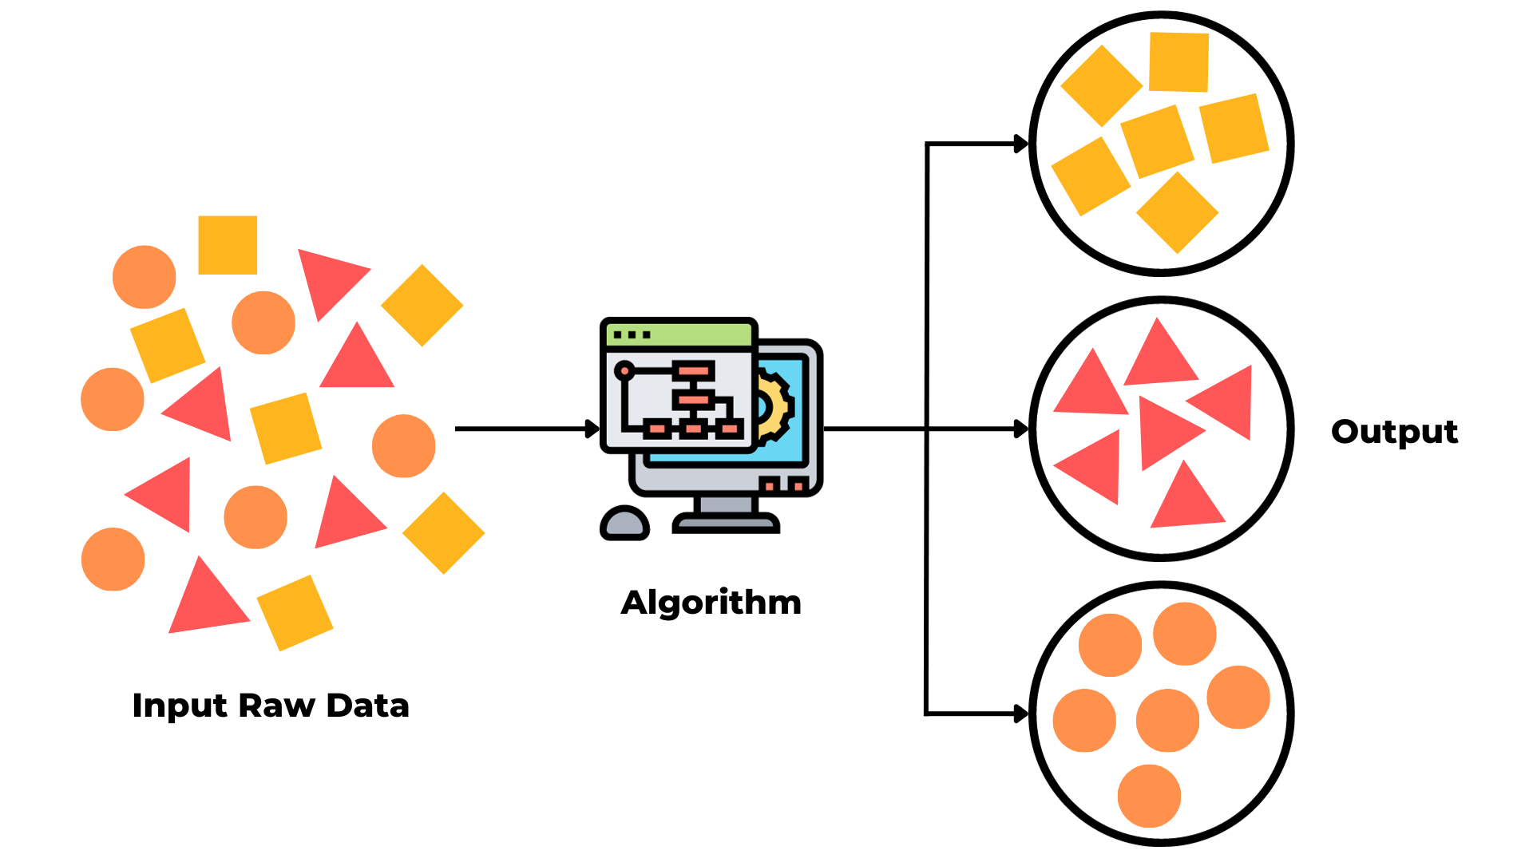
Unsupervised learning:
Unsupervised learning is a type of machine learning algorithm where the model learns from unlabeled data, meaning there are no predefined target labels.

Slide 12
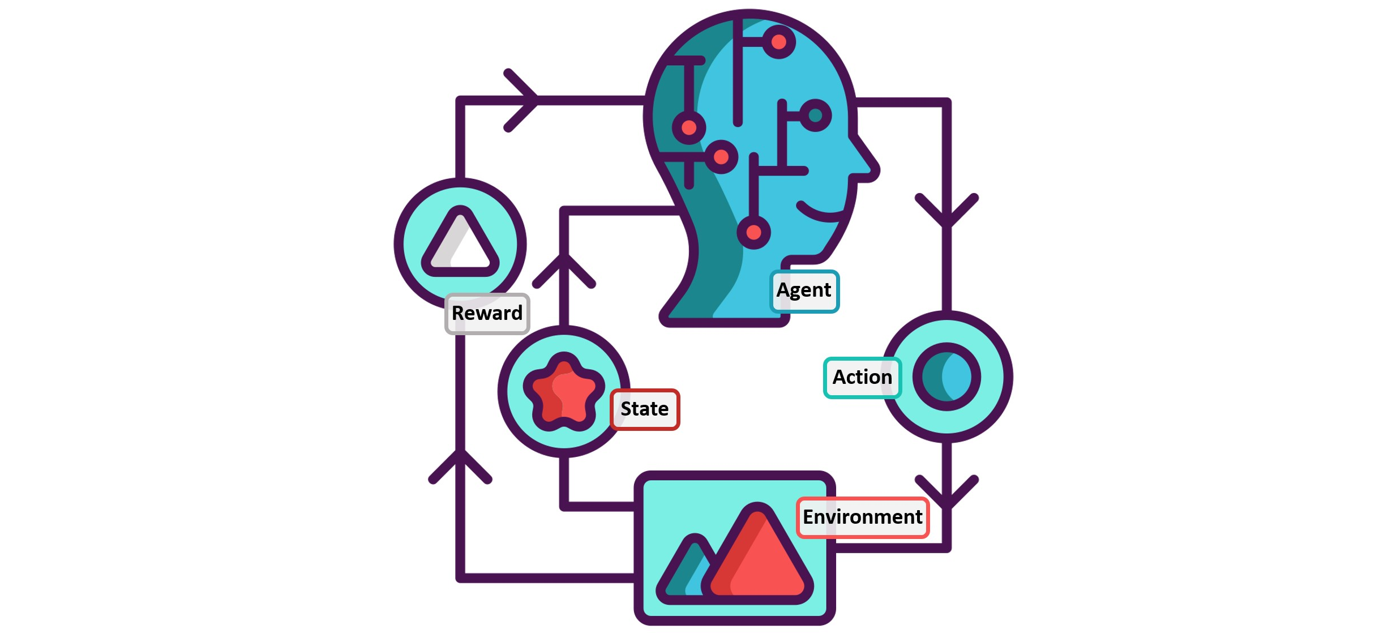
Reinforcement learning:
Reinforcement learning is a type of machine learning algorithm where an agent learns to make decisions by interacting with an environment. The agent receives feedback in the form of rewards or penalties based on its actions, and its goal is to learn the optimal strategy to maximize cumulative rewards over time.

Slide 13
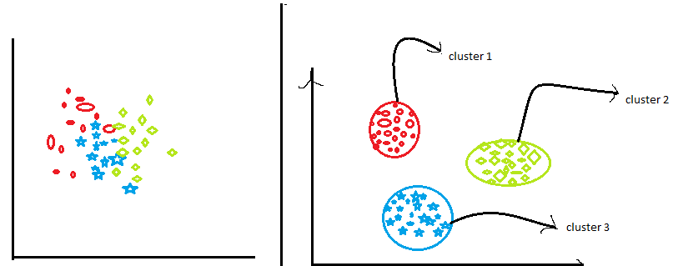
Clustering:
Clustering is a technique in unsupervised learning where data points are grouped into clusters based on their similarity or proximity to each other, without any predefined labels.

Slide 14
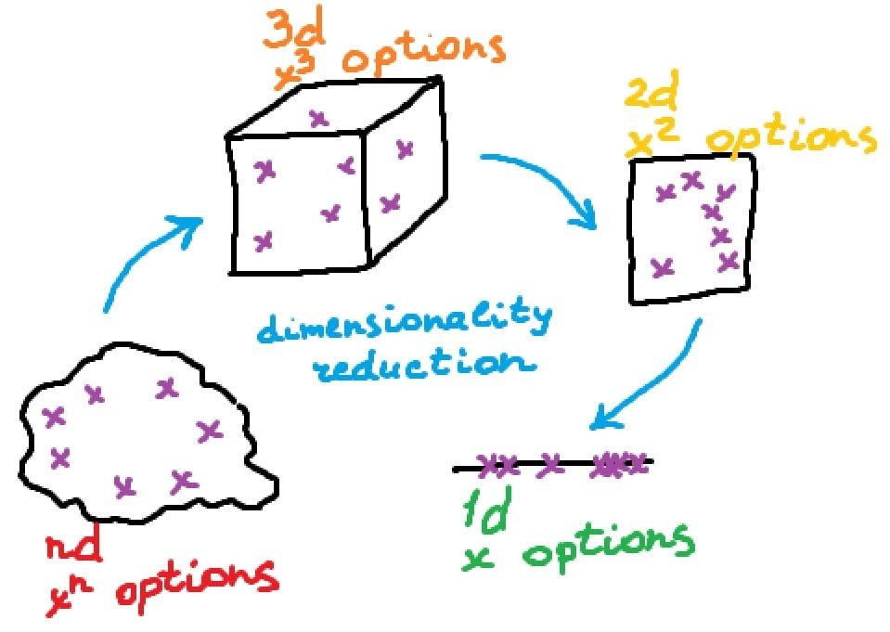
Dimensionality Reduction:
Dimensionality reduction is a process in machine learning and statistics aimed at reducing the number of features or variables in a dataset while preserving important information. It helps to simplify the dataset by representing it in a lower-dimensional space, making it easier to visualize, analyze, and process.

Slide 15
Anomaly detection:
Anomaly detection is a technique used in machine learning to identify data points that deviate significantly from the norm or expected behavior within a dataset. These data points, known as anomalies or outliers, may represent unusual patterns, errors, or fraudulent activities.

Slide 16
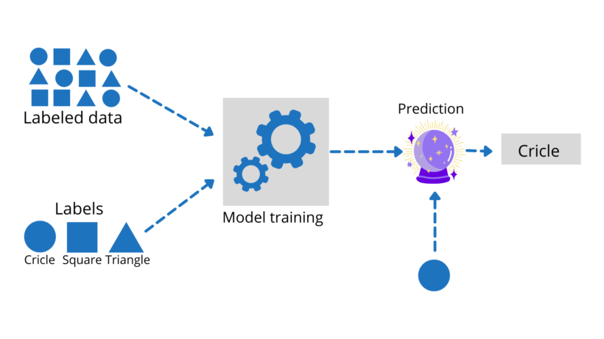
Supervised learning

Slide 17
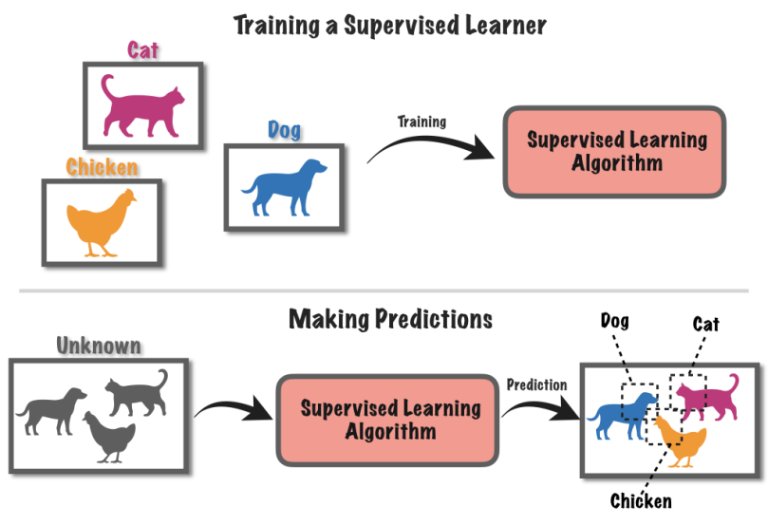

Slide 18
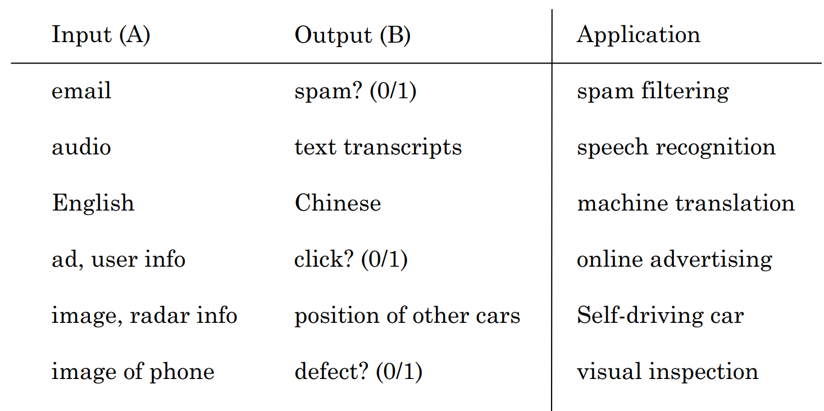
Supervised Learning Applications

Slide 19
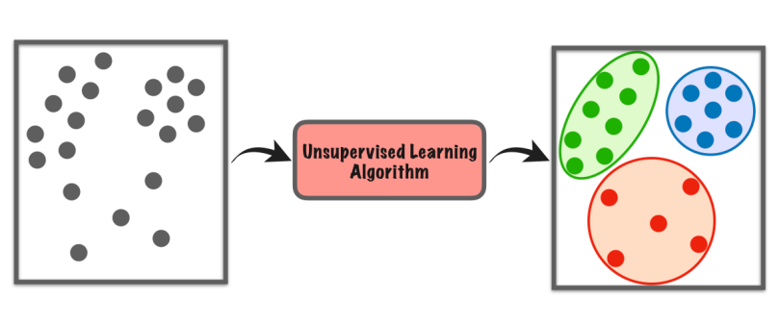
Unsupervised learning
Clustering
Dimensionality Reduction
Anomaly Detection

Slide 20
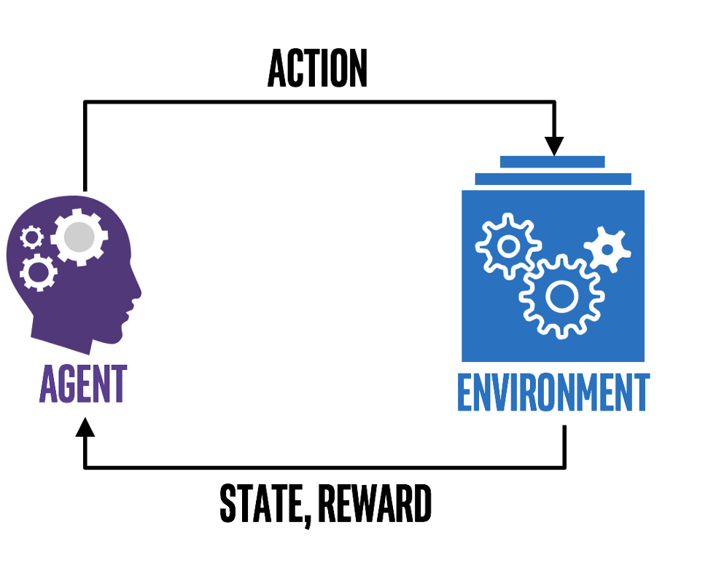
Reinforcement Learning

Slide 21
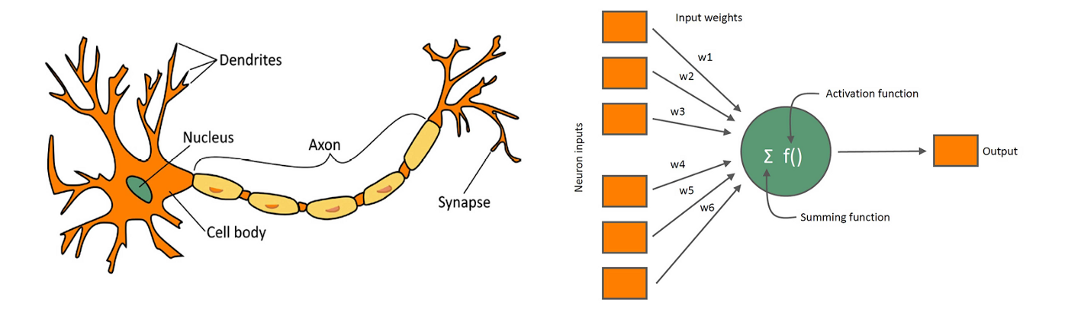
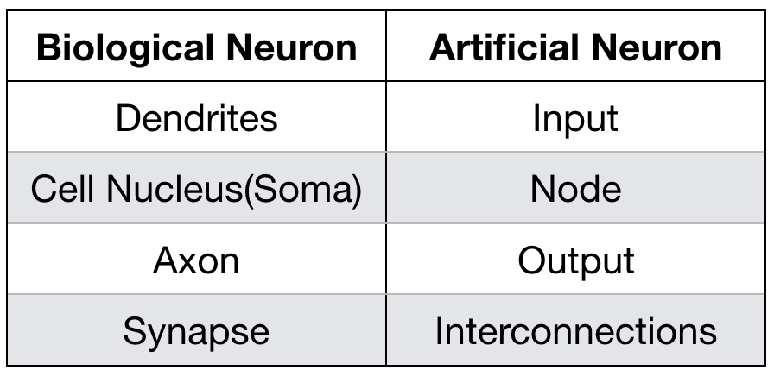
Biological Neuron
Artificial Neuron

Slide 22
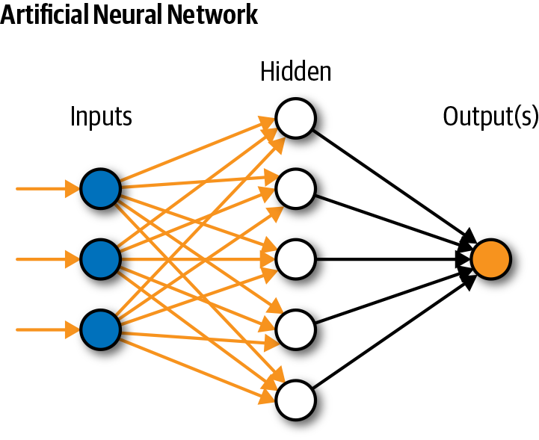
Neural Network

Slide 23
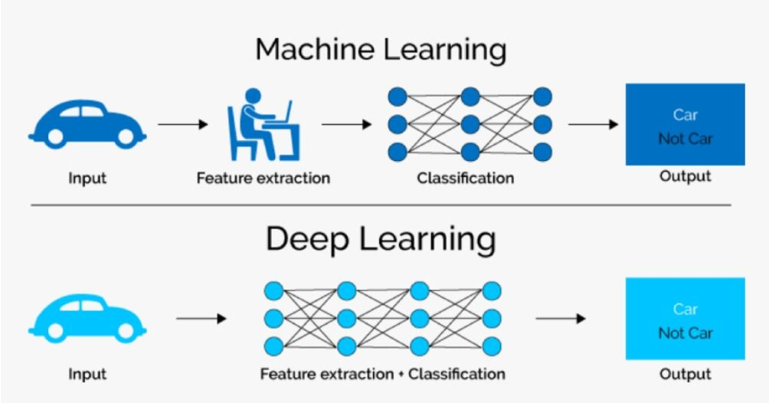
ML vs. DL

Slide 24
Week Summary
What is AI?
ANI & AGI
Machine Learning vs Deep Learning

Slide 25
Next Lecture:
Lecture 03 - Deep Learning
Click Here

